Slide 1
Verifiable Mixing Protocol
How can a mixer prove its integrity?

Slide 2
Basics
VMP allows the mixer to prove that it paid the address specified by the user.
It provides a way for mixing services to:
        Build trust quickly
        Resist fraudulent claims of failure to pay
VMP does NOT improve anonymity.

Slide 3
Setup
The mixer has to give up some info:
    Input addresses the mixer uses
    Output addresses (T) paid by the mixer
        Signatures of T: Φ
    Keys g, h
1. User sends coins to mixer, specifies address m
2. Mixer picks random r (prevents exploitation)
3. Transaction includes commitment C = g^{m}h^{r}

Slide 4
Caveats
User's choice of m should be unique
    Protocol gets more complicated otherwise
If user fails to follow protocol, return money
    Protects mixer from intentionally unverifiable payments

Slide 5
Verify
Verifier wants to check that the address specified in input transaction i was paid.
Public knowledge: g, h, C, T, Φ
Mixer knows: m, r
Prove: m ϵ T and C commits to m
Don't need to reveal m

Slide 6
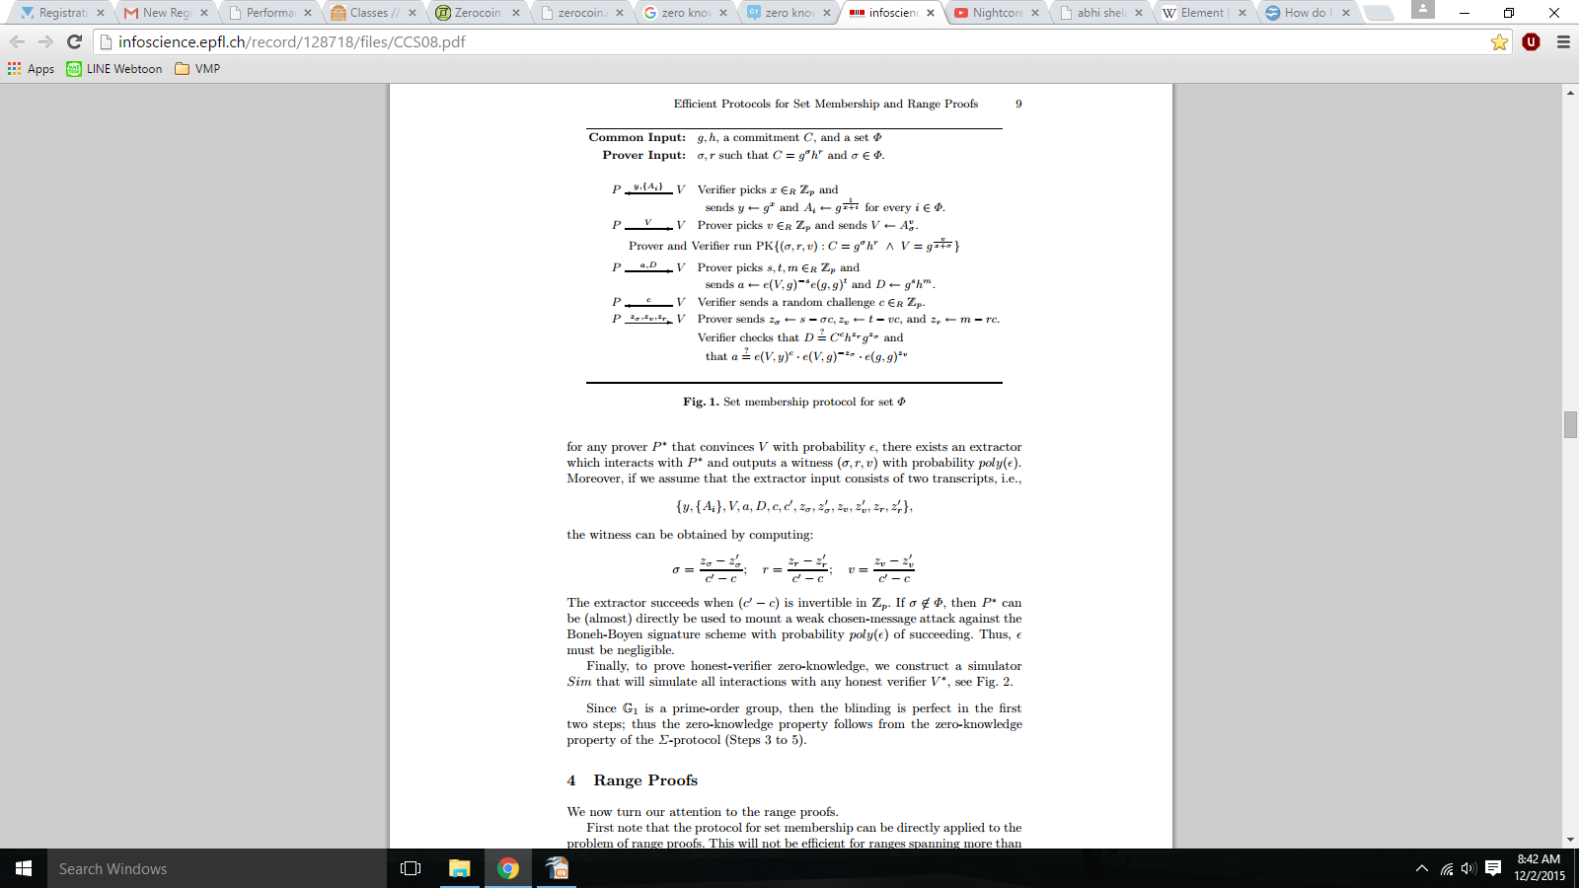
Verify
Zero-knowledge set membership proof
By Camenisch, Chaabouni, and Abhi Shelat

Slide 7
Confirming Value
How do we know that the mixer payed enough?
Have T only include transactions in correct range.
This would require outrageous volume to be safe.
Traditional mixing solutions still apply.

